Slide 1

BÀI THUYẾT TRÌNH
SUMMARY HA DASHBOARD
TRẦN ĐỨC THẮNG - MEMTORSHIP PROGRAM - 2024
MENTOR BY DAO VO

Slide 2
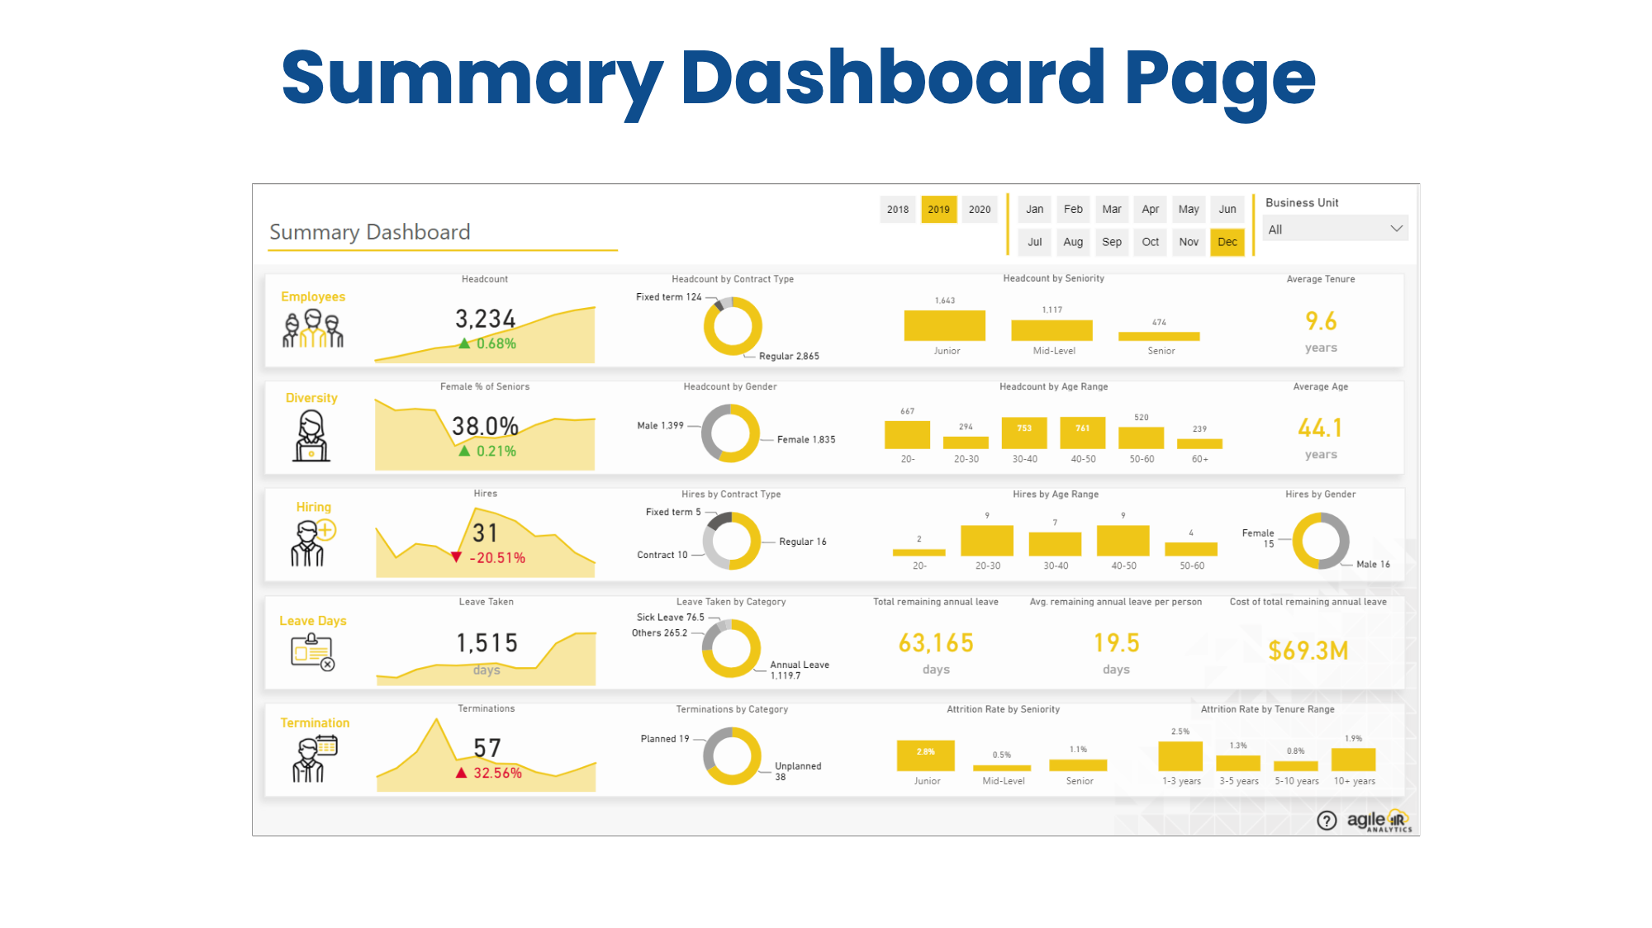

Slide 3
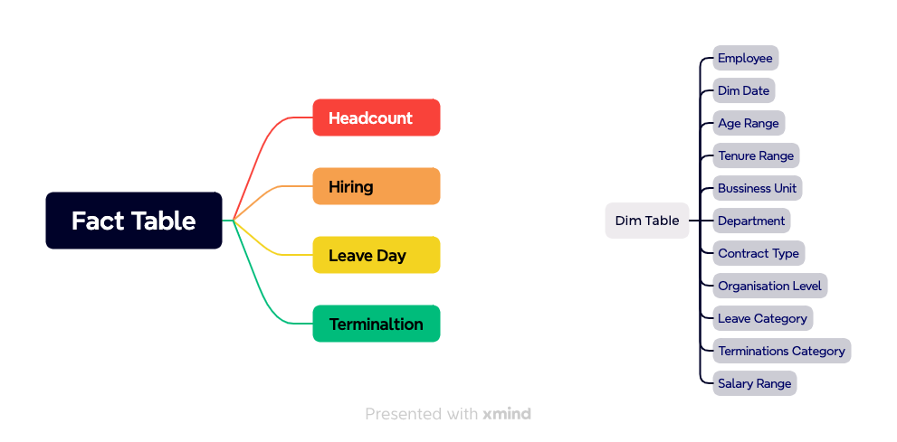
TOPDOWN APPROACH

Slide 4
Detail

Slide 5
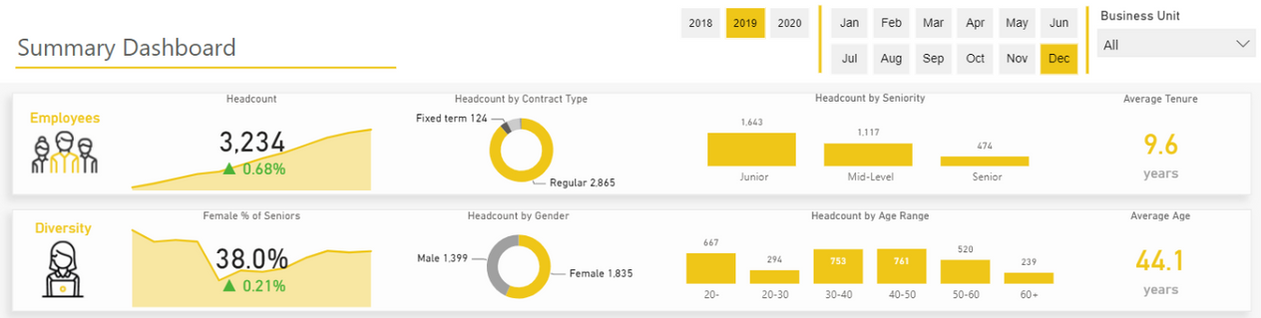
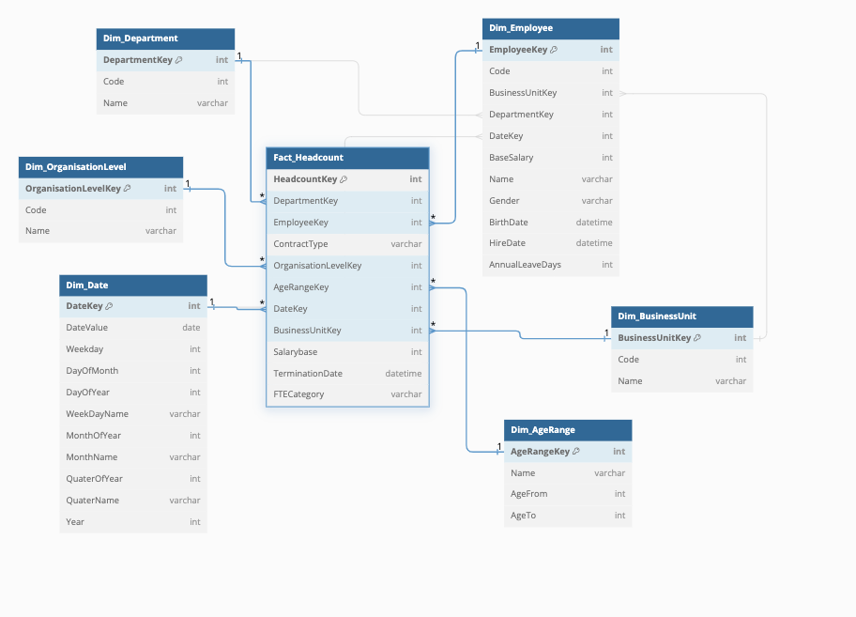
Fact HeadCount

Slide 6
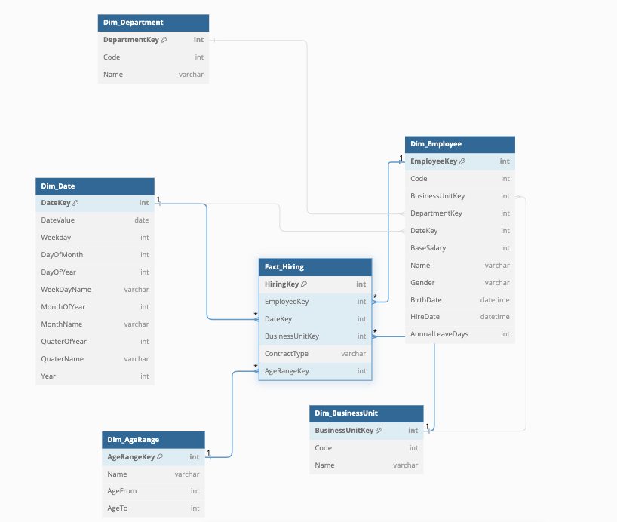
Fact Hiring

Slide 7
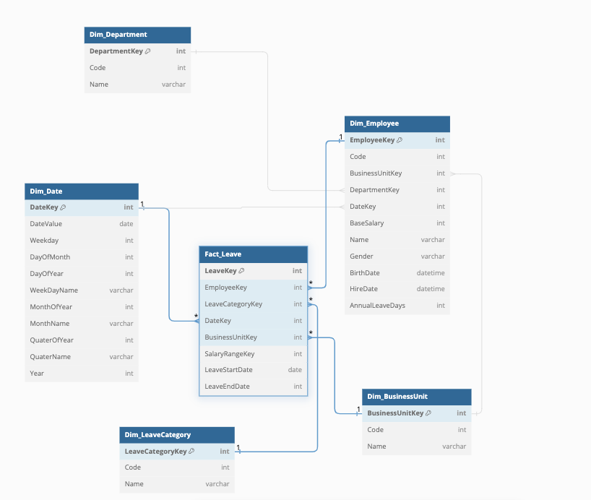
Fact Leave

Slide 8
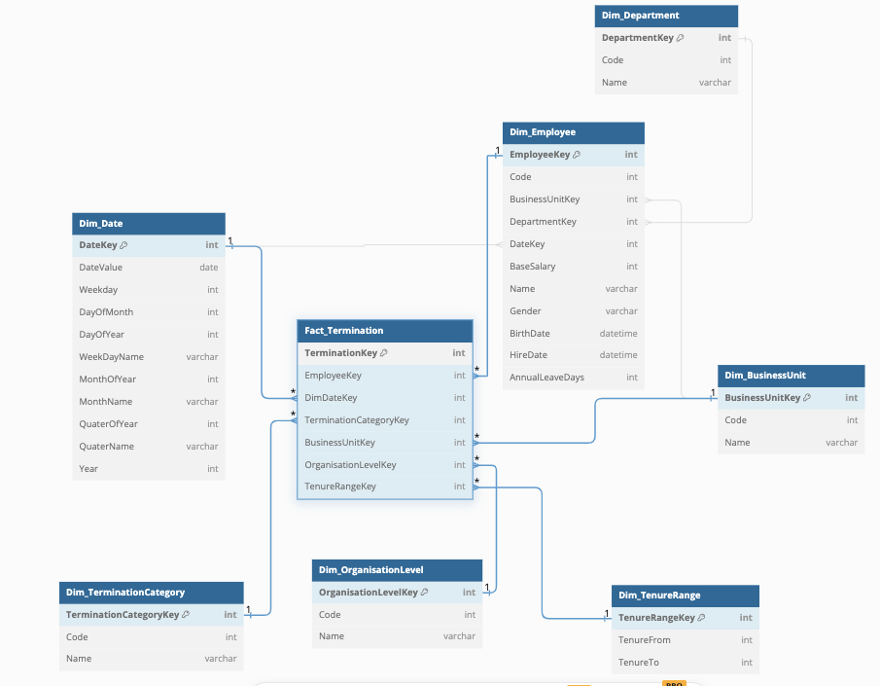
Fact Termination

Slide 9
Thank you for watching

